Slide 1
Digital Portfolio
STUDENT NAME: A.Fathima nachiyar
REGISTER NO AND NMID:asanm41124134110500122008
DEPARTMENT: BCA(Bachelor of Computer Applications)
COLLEGE: COLLEGE/ UNIVERSITY: Vivekananda College of arts and science for women/Annamalai University

Slide 2
PROJECT TITLE Colour & Animated Portfolio design...

Slide 3
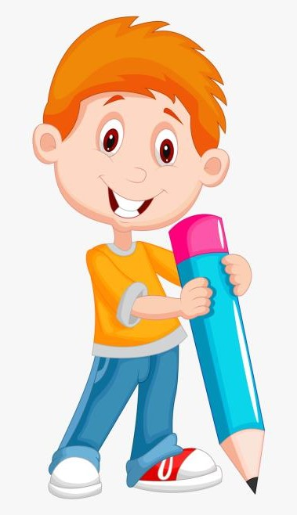

AGENDA
Problem Statement
Project Overview
End Users
Tools and Technologies
Portfolio design and Layout
Features and Functionality
Results and Screenshots
Conclusion
Github Link
3/21/2024 Annual Review

Slide 4

PROBLEM STATEMENT
Students often struggle to showcase their skills, projects, and achievements in a modern, attractive, and interactive way.
Traditional resumes and plain portfolios lack interactivity, visual appeal, and personalization.

Slide 5
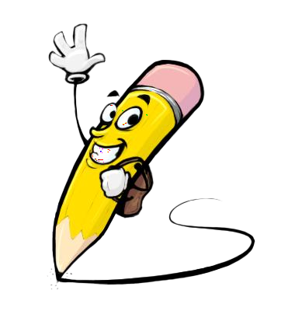
PROJECT OVERVIEW
This project is a Colorful Animated Student Portfolio Website designed to help students present their:
About Me – A self-introduction with animated headings 🌟
Skills – Technical abilities listed with icons 💻
Projects – Highlighting academic and personal works 📚
Education – Academic qualifications 🎓
Contact – Easy communication via email, LinkedIn, or GitHub 📬

Slide 6

WHO ARE THE END USERS?
Students 🎓
To create and showcase their personal portfolio.
Present skills, projects, and achievements in a modern way.
2. Recruiters / Employers 💼
To quickly view a student’s skills, education, and project experience.
Helps in hiring or internship selection.
3. Teachers / Mentors 👩‍🏫
To evaluate students’ work, creativity, and technical knowledge.
4. Peers / Classmates 🤝
To collaborate on projects and get inspiration from others’ portfolios.

Slide 7

TOOLS AND TECHNIQUES
Tools: VS Code, Web Browser, GitHub (optional), PowerPoint
Techniques: HTML5 for structure, CSS3 for design & animations, JavaScript for interactivity, Responsive Web Design

Slide 8
POTFOLIO DESIGN AND LAYOUT
Header – Title & navigation
About – Student intro
Skills – Technical abilities
Projects – Academic work
Education – Qualifications
Contact – Links & email
Footer – Copyright
✨ Colorful, animated, and responsive design.
8

Slide 9
FEATURES AND FUNCTIONALITY
Add profile picture upload feature 📸
Contact form with backend support 📬
More animations & themes 🎨
Project gallery with filters 📂
Mobile-first advanced responsiveness 📱

Slide 10
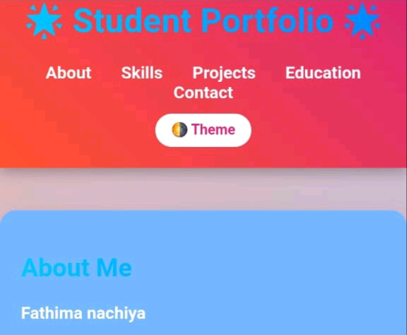

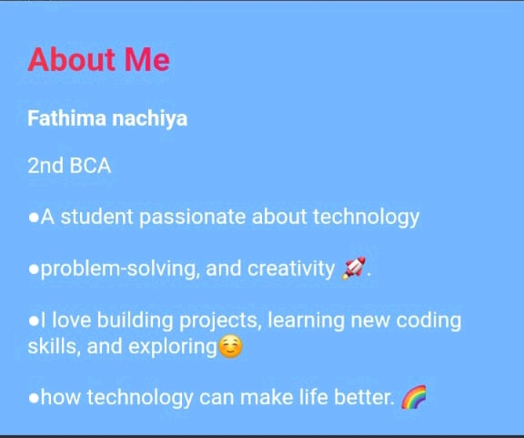
RESULTS AND SCREENSHOTS
3/21/2024 Annual Review
10

Slide 11
CONCLUSION
A colorful, animated, and responsive student portfolio to showcase skills, projects, and achievements effectively.
https://github.com/kathijabeevi1311-rgb/Fathima-TNSDC-FWD-DP1.git
11

